Slide 1



API Design for ETL
Lessons from Nearly 100 Data Integrations in the Wild
Dan Mosora
Sources Software Engineer
Talend – Stitch Data Loader
github.com/dmosorast/api-design-for-etl
Notes:
Hello CodeMash! Long time listener, first time caller. ...
Feel for the room:
Working on an API public or private for ETL as part of their day job?
Interested in ETL?
Session you wanted full?
Because you know me?
Intermediate level session, some assumptions are made
Many different facets of software, encouraged to take what you can
My main goal is to tell you a story, maybe a love story, maybe a drama, hopefully a good story, and
all in all this will be wrapped up in 4 lessons from 4 different spaces

Slide 2
Backstory
Data is complicated
Notes:
These are lessons from my and my team’s experiences,
Thought fair to start off with a bit of what that is.
I initially started working in Enterprise software, which may be a familiar space to some of you. It was a dotnet shop, writing C#, and I learned so much about design patterns, architectures, domain driven design, MVC, what an API is, among other things. I also learned a lot about Visual Basic 6, and ASP classic, and legacy code whose last verifiable change may have occurred somewhere around 20 or so years ago, judging by the comments. <Pause, think>
Large systems in enterprise software have a lot of history, a lot of age, and a lot of different shapes of data. <Pause> This is about when I realized that data is complicated.

Slide 3


Slide 4
Level Setting
Notes:
Before I get started,
ETL is a broad term in a broad space
Means a lot of different things to different people

Slide 5
ETL vs. ELT
Notes:
There are a lot of letters there.
So, lets funnel this down a bit because I’m coming from a very specific place.
It may or may not be a surprise that ETL stands for Extract, Transform, and Load. There is also a separate approach called ELT, which performs the transformation in the warehouse, using things like SQL views, functions, and/or stored procedures.
When you are building a custom pipeline for ETL, having the transform step in between may affect your needs in the Extraction step. There is an implicit dependency between the data you Extract and the Data you Transform.
ELT, on the other hand, is all about extracting and loading the most raw data possible, so that transformations can be completed after loading, <PAUSE> and you see this coming up more and more with modern data warehouses that are designed for this type of workload. <PAUSE>

Slide 6
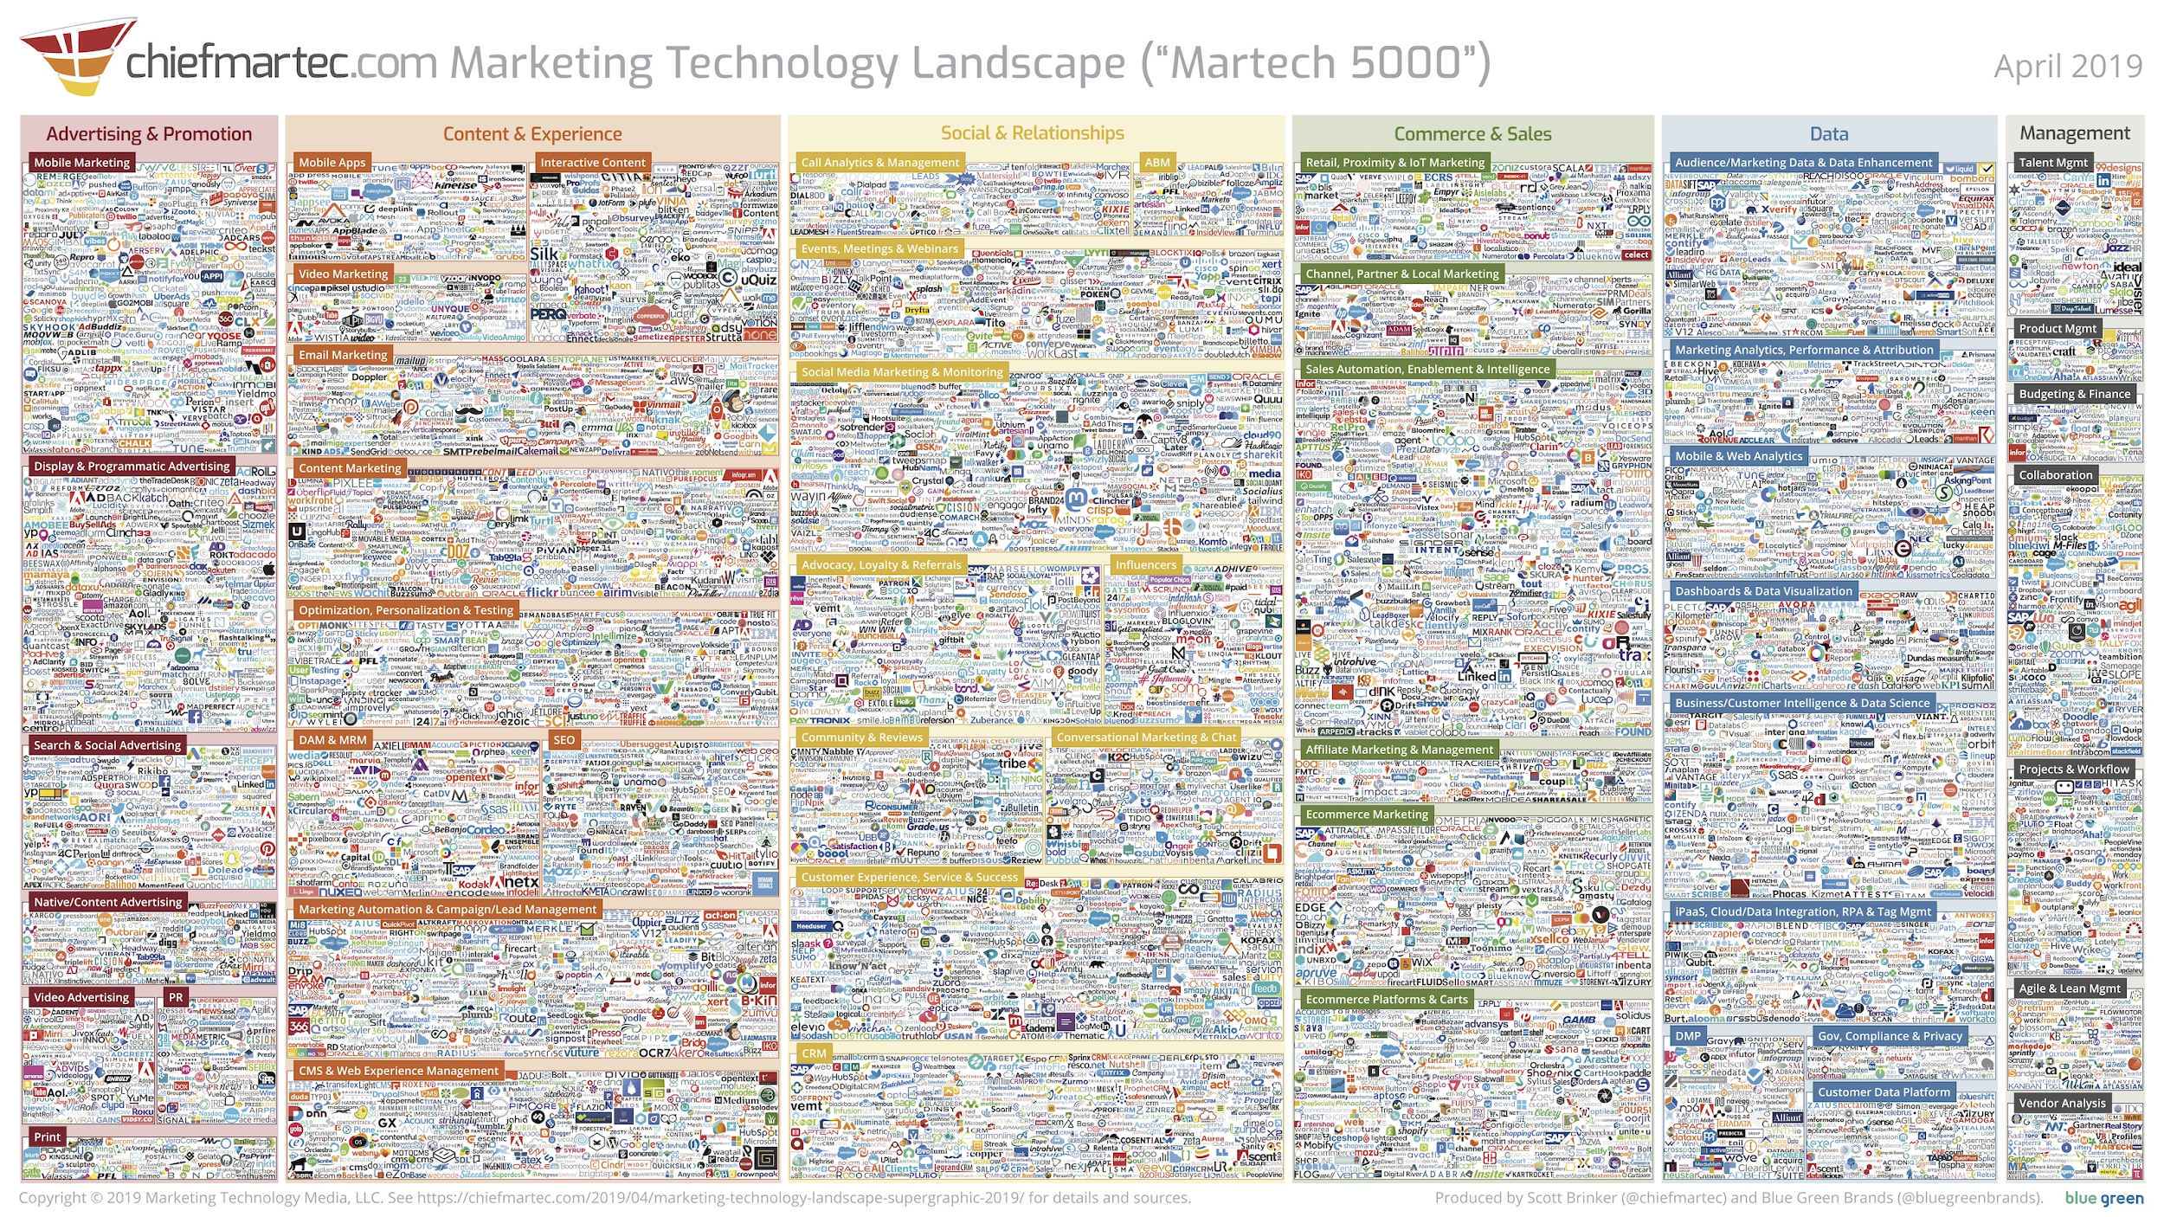
Notes:
The other side of where I’m coming from is this graphic. <PAUSE>
This is what has come to be called the Martech 5000 from a fellow named Scott Brinker on his site chiefmartec.com. It lists all of the companies that provide services in the marketing technology space. If you look closely, your companie’s logo might be on this slide…. Not the best way to name drop, but I like to cast a wide net.
I first saw this two years ago and it was much more readable. This is the most recent edition…
It’s been growing year over year, and is now up to over 7000 companies.

Slide 7
What this talk is...
Lessons from real interactions with APIs
Inspiration to start a discussion about these things
My black-box perspective as a USER of APIs

Slide 8
What this talk is NOT...
NOT criticism of APIs that have been hard to work with
NOT advice about the meaning of the data
NOT advice on specific implementation details

Slide 9
Goals and Vision
API Interactions
Data Modeling
Non-Functional Requirements
Authorization

Slide 10
Goals and Vision
Notes:
So! Goals and Vision...

Slide 11
Efficiently Use Resources
Goals and Vision
Notes:
Backend software, want to make sure there’s a minimum level of performance
Computers cost money, eat electricity, make heat.
When I and my team interact with APIs, this is exactly the same, except it’s not just our resources. It’s the resources being used to serve the request
And because these things are hosted and run automatically, I don’t want to accidentally DDoS you.

Slide 12
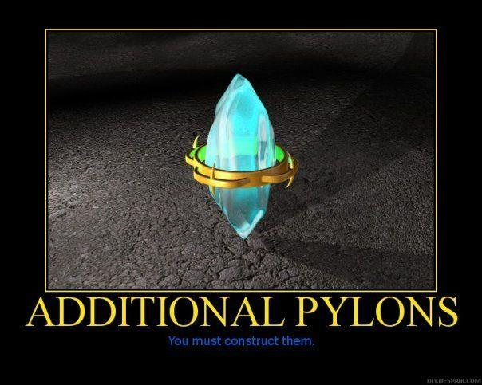
^
not
https://knowyourmeme.com/photos/16265-you-must-construct-additional-pylons

Slide 13
Spread the Word
Goals and Vision
Notes:
The other side of the coin is that I want to share with you
Some things picked up along the way
I haven’t seen much representation of this specific use case in API Design, so
Potentially start a conversation about it.
With that...

Slide 14

https://www.pinterest.com/pin/839499186761318979/

Slide 15
Lesson 1 in API Interactions
Notes:
Describe what I mean by “Interaction”

Slide 16
Where We Are
API
(You are here.)
Our Customer’s
Data Warehouse
Extraction
Loading
(I am here.)
We, together, are here.

Slide 17
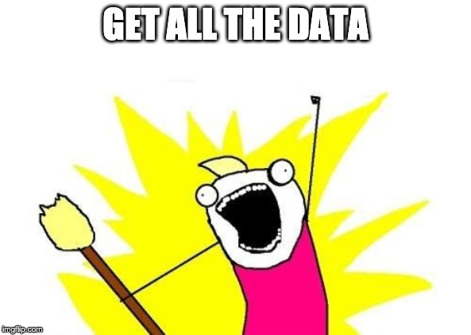
Anatomy of an ELT API Interaction
ALL the data
Reliably
Efficiently

Slide 18
Case Study – CodeMash Attendees
id | name | ctf_rank
be57ca75 | Alister Pawson | 3
da7acafe | Sam Wisen | 1
feedaca7 | Jordan Sanovich | 2
How can we get ALL this data?

Slide 19
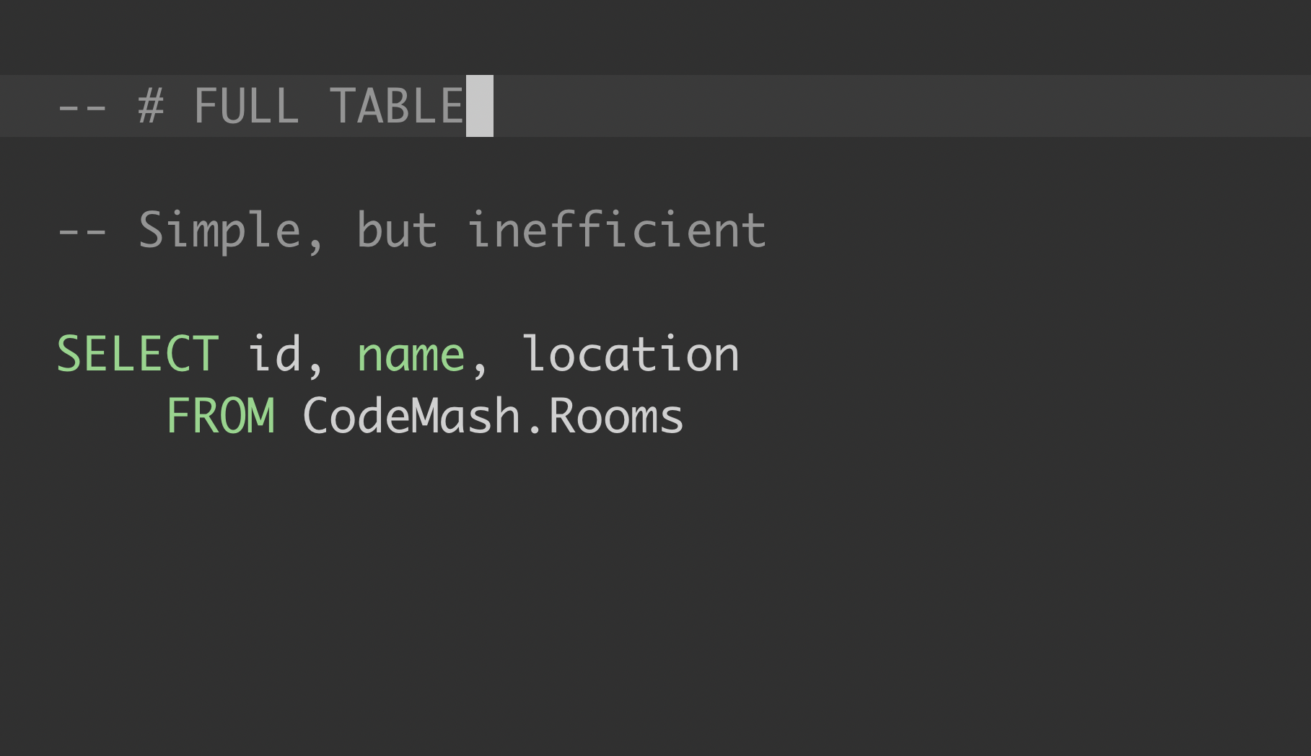
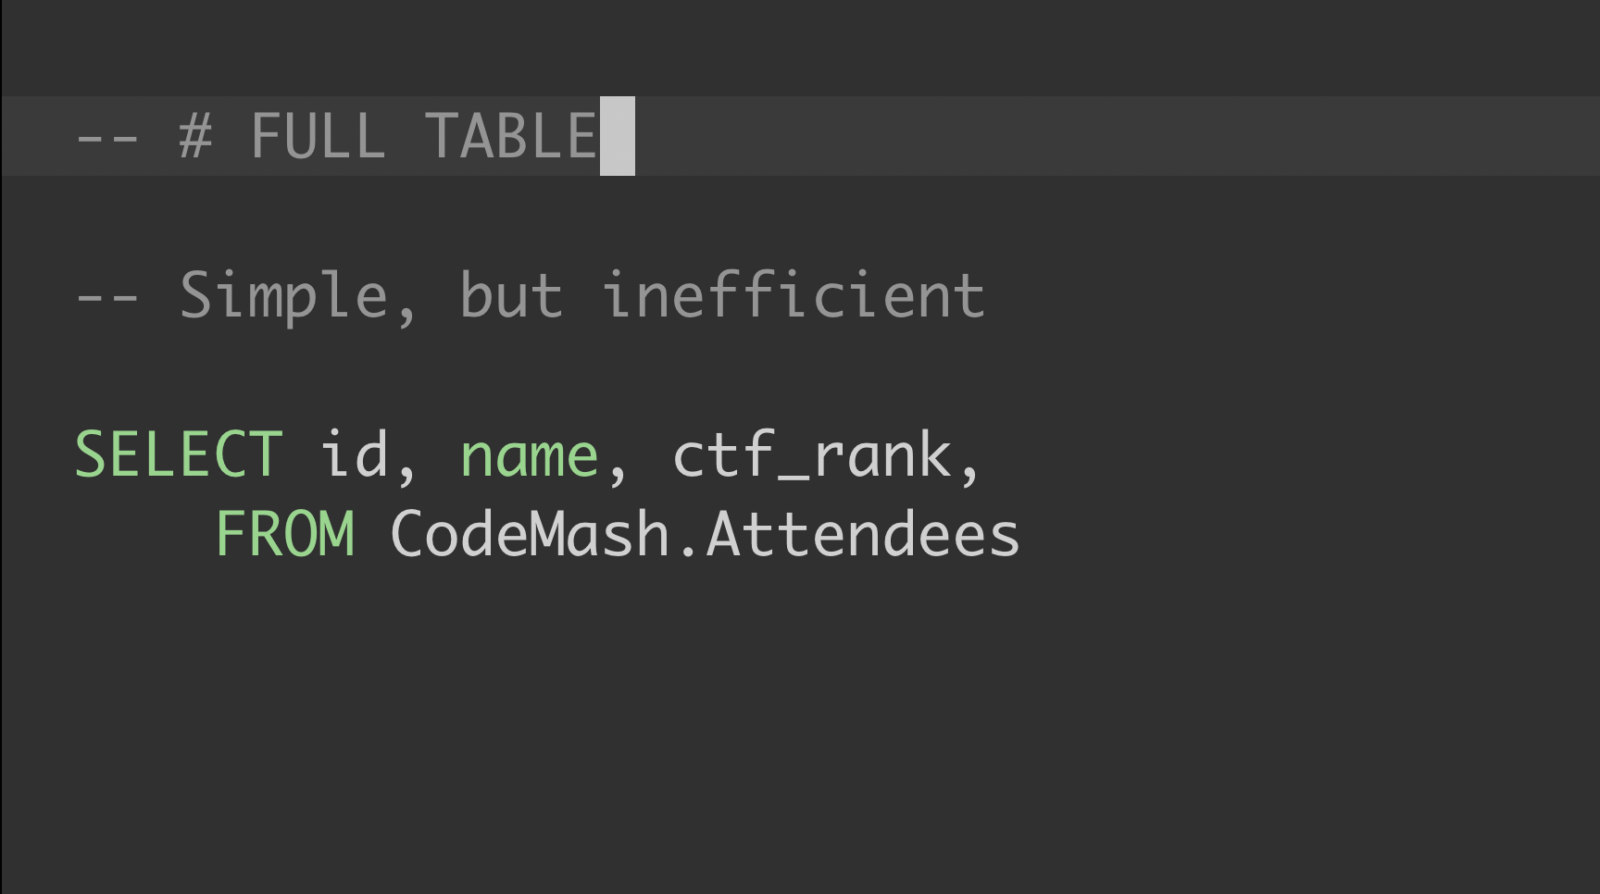

Slide 20
Remember...
^
not

Slide 21
Case Study – CodeMash Attendees
id | uniqueidentifier
name | varchar(255)
ctf_rank | byte
registered_at | datetime
last_slept | datetime

Slide 22
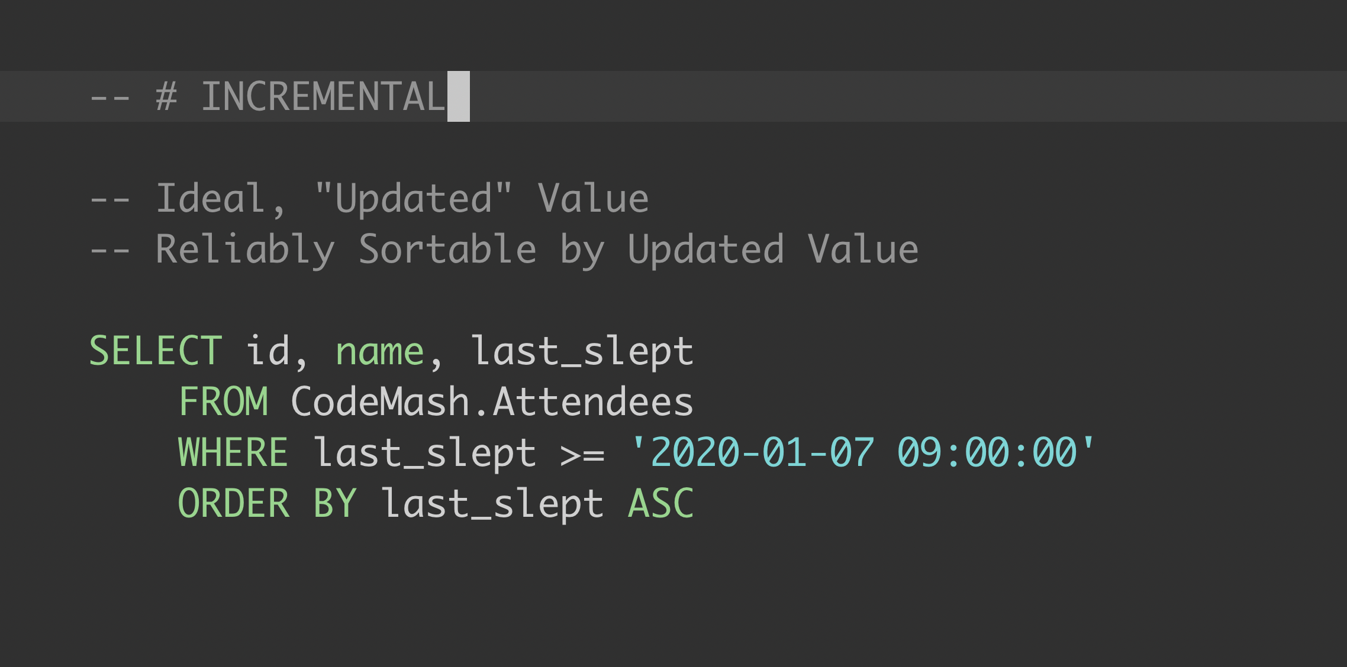
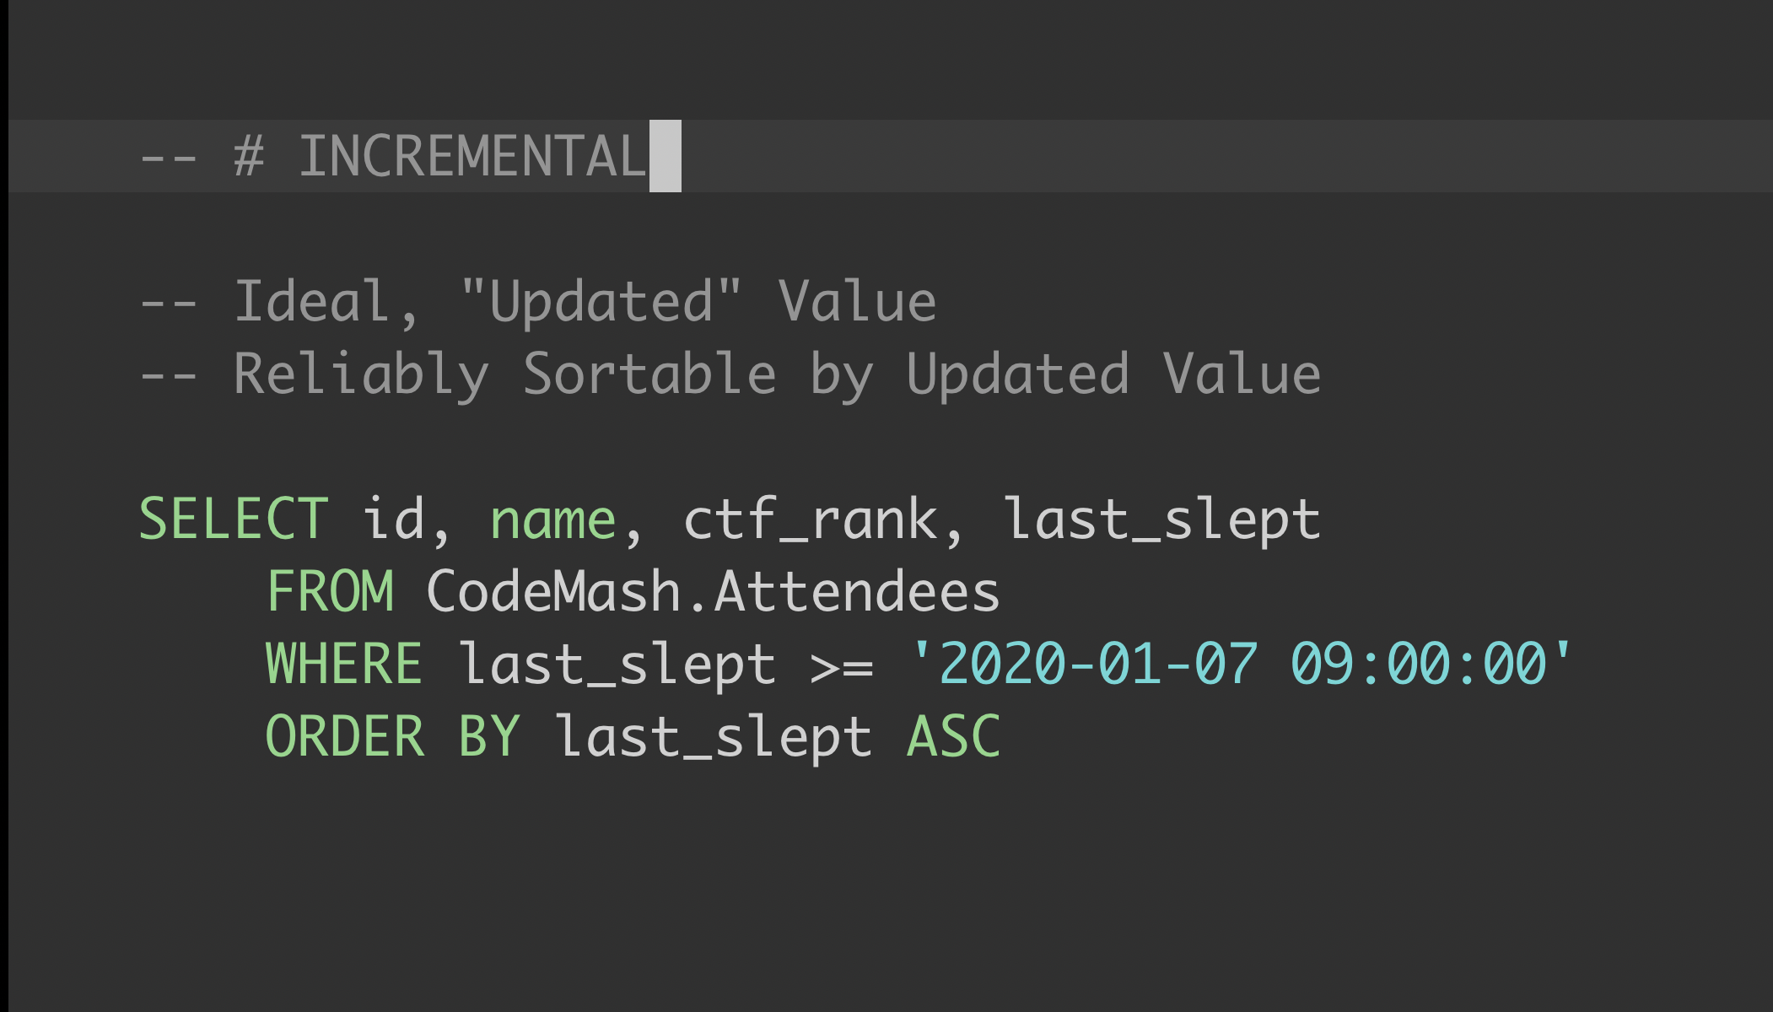
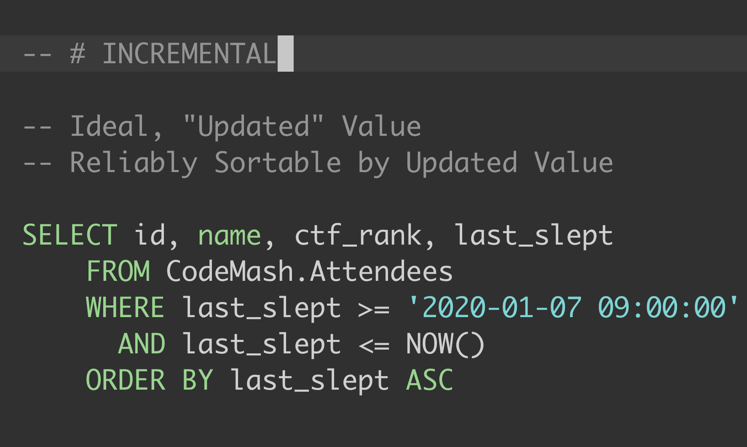

Slide 23
Lesson 1: Shoot for Database-like Interactions
Field Selection
Resuming
Sorting

Slide 24
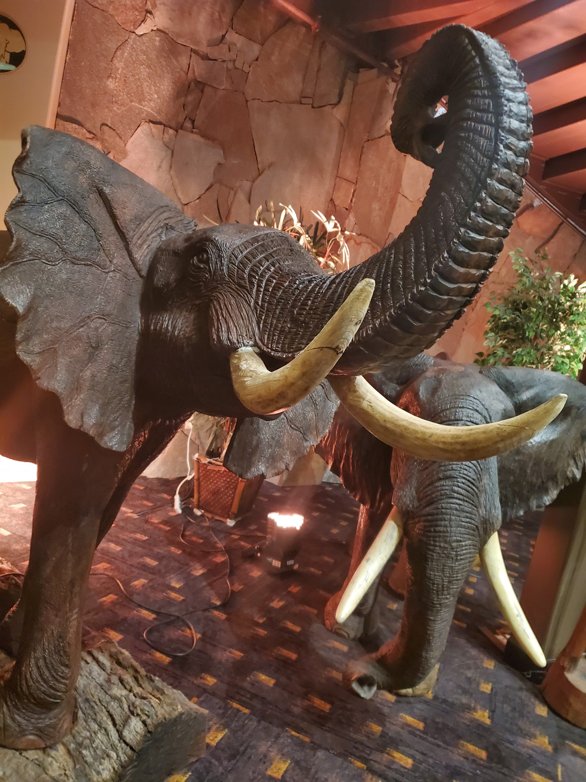
Lesson 1: In The Wild
xql_filter = "updated >= '%s' order by updated asc" % "2019-01-08T07:00:00Z"
GET /tickets?
updated_since=2019-01-08T07:00:00Z
order_by=updated
order_type=asc
include=time_to_resolution,assignee,tags
HTTP/1.1
Host: agilely.io
Notes:
Agile project management tool

Slide 25
Lesson 2 in Data Modeling

Slide 26
Anatomy of an ELT Data Model
CodeMash
.Attendee
GET /attendees/{id}/kidz
1
0..*
KidzMash
.Attendee
Notes:
Domain Modeling

Slide 27
Anatomy of an ELT Data Model
GET /attendees/1234/kidz/
GET /attendees/1235/kidz/
GET /attendees/1236/kidz/
GET /attendees/1237/kidz/
GET /attendees/1238/kidz/
GET /attendees/1239/kidz/
GET /attendees/1240/kidz/
GET /attendees/1241/kidz/
...
Notes:
WithoutAn HTTP

Slide 28
Anatomy of an ELT Data Model
CodeMash.Attendee
CodeMash.Attendee
KidzMash.Attendee
1
0..*
KidzMash.Attendee
Notes:
Domain Modeling

Slide 29
Anatomy of an ELT Data Model
GET /attendees/1234/kidz/
GET /attendees/1235/kidz/
GET /attendees/1236/kidz/
GET /attendees/1237/kidz/
GET /attendees/1238/kidz/
GET /attendees/1239/kidz/
GET /attendees/1240/kidz/
GET /attendees/1241/kidz/
...
GET /attendees/
GET /kidz/
...fin
Notes:
WithoutAn HTTP

Slide 30
Lesson 2 – Avoid Sub-Resources
for account in get_accounts() {
for department in get_departments(account.id) {
for user in get_users(account.id,department.id) {
for invoice in get_invoices(account.id, department.id, user.id) {
write_to_pipeline(invoice)
}
}
}
}

Slide 31

Lesson 2: In The Wild
First Attempt: 4 Requests Each
Tickets
/<ticket_id>/stats
/<ticket_id>/events
/<ticket_id>/comments
Notes:
Support desk tracking software

Slide 32
Lesson 3 in Non-Functional Requirements
Notes:
Non functional requirements sometimes get a bad rap

Slide 33
Non-Functional Requirements
Reliability
Data Typing
Error Messaging

Slide 34
Reliability
R1
POST
CodeMash Attendees Back End
Highly Distributed
(Microservices)
Extraction
Process
last_slept : T1
R2
POST
R1
R2
CodeMash Attendees Front End

Slide 35
Data Typing
Discoverable
Consistent
GET /api/describe
12
0.0
VS.

Slide 36
Error Messaging
HTTP 200 OK
{“status”: “error”}

Slide 37
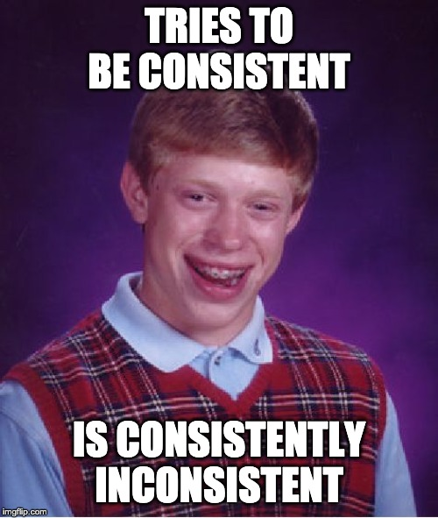
Lesson 3 – Be Consistent
https://imgflip.com/memegenerator/Bad-Luck-Brian

Slide 38
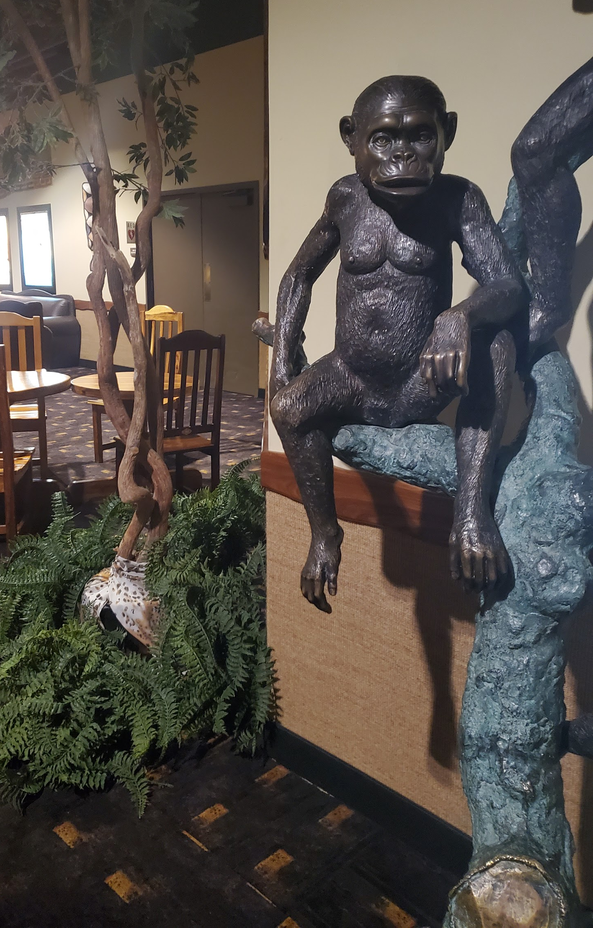
Lesson 3: In The Wild
[error for error
in ex.fault.detail.FaultDetail.errors
if error.ErrorType == “AuthError”]

Slide 39
Lesson 4 in Authorization

Slide 40
Authorization
...user generated, easy to revoke and recreate
...encrypted, nonced, signed, validated requests
...three-legged handshake, no password exchanged
...credentials appear directly in request headers
… … it happens!
Token-Based
OAuth1
OAuth2
Basic Auth
One of these and then some?
It really depends on your security needs...

Slide 41
Authorization – Guidance
...give users the ability to easily revoke tokens
...complicated, keep to spec and document
...allow viewing/control over redirect_urls, client ID, secret...
...please don’t put credentials in the URL string
… … document it!
Token-Based
OAuth1
OAuth2
Basic Auth
One of these and then some?

Slide 42








API Documentation
Scopes
Examples
GET /oauth/token
&scope=invoices.read, invoiceItems.read,...
All Images

Slide 43

Lesson 4 – Empower Your API Users
https://imgflip.com/memetemplate/196061783/hide-the-pain-harold-drummer

Slide 44
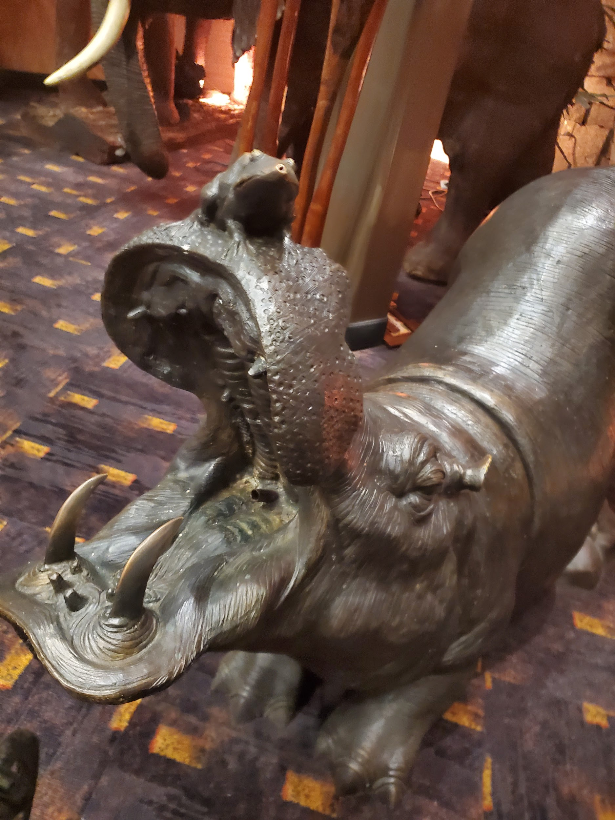
Lesson 4: In The Wild
Scopes are period-separated strings with a pluralized resource name (e.g. "leads") and a level of access (e.g., read, write, delete or all). For example, …
(Condensed and Paraphrased for brevity and to protect the identities of those involved.)
Notes:
CRM System
prospect_accounts? prospectAccounts? prospectaccounts?

Slide 45
API Interactions
Shoot for Database-Like Interactions
Data Model
Avoid Sub-Resources
Non-Functional Requirements
Be Consistent
Authorization
Empower Your API Users

Slide 46
Conclusion
Everything’s a balance. It’s tough.
Between your App’s needs, your customer’s needs, your infrastructure, security, the nature of the data, etc.
These are just a few of the big points to help guide you when making decisions, so that we can work together for the benefit of our mutual customers as the amount of APIs grows every year

Slide 47
END
(thank you!)
(please leave feedback in the app)
Slack (singer.io) – @dmosora
Slack (CodeMash) – @danmosora
Slides: github.com/dmosorast/api-design-for-etl

